Slide 1
Medical Charges Prediction
Presented By: Nitin Bhore

Slide 2
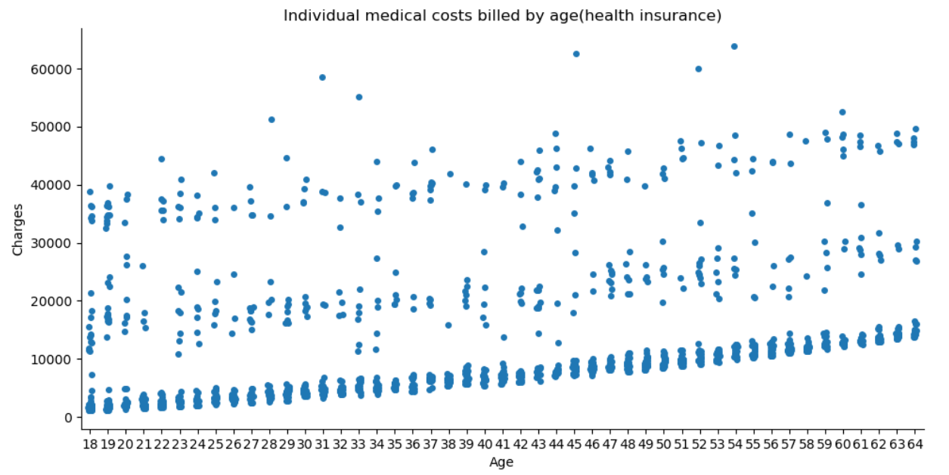
EDA and Data Insights

Slide 3
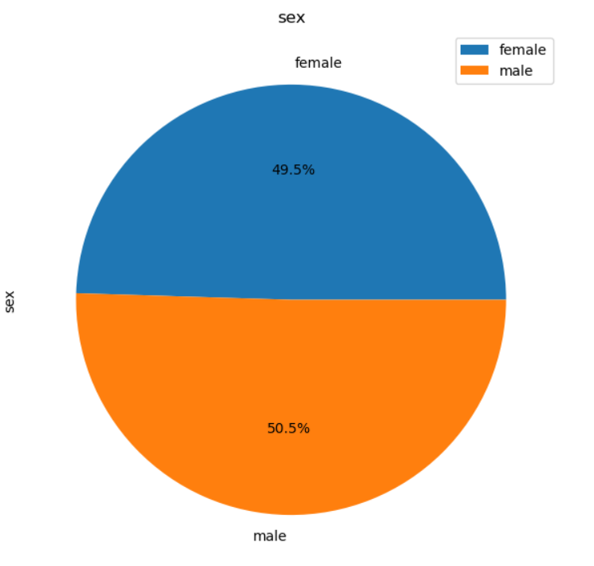
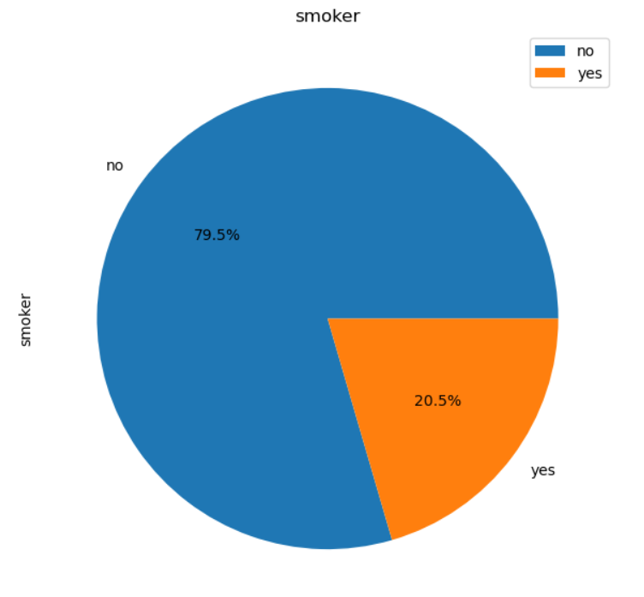
EDA and Data Insights

Slide 4
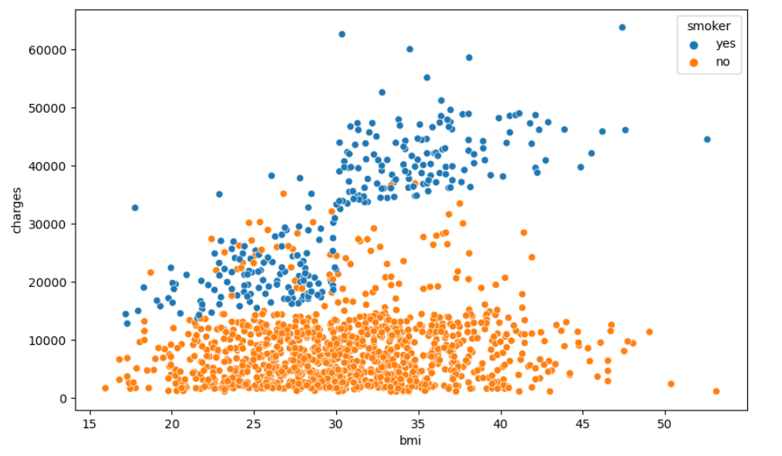
EDA and Data Insights

Slide 5
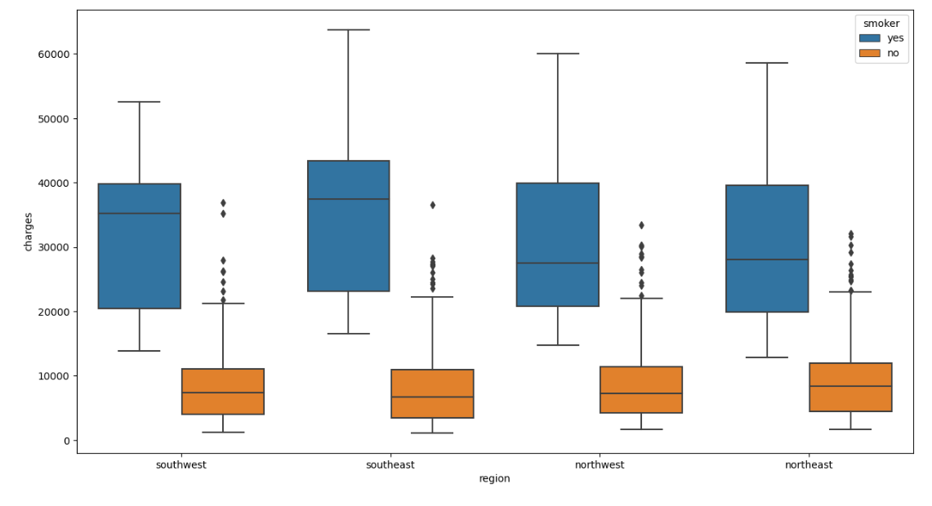
EDA and Data Insights

Slide 6
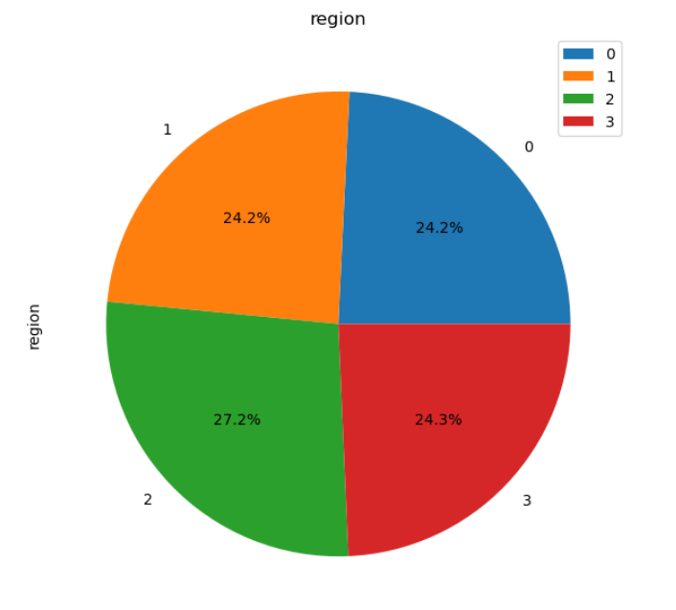
EDA and Data Insights

Slide 7
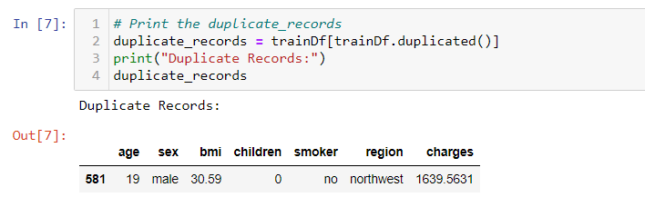
EDA and Data Insights

Slide 8
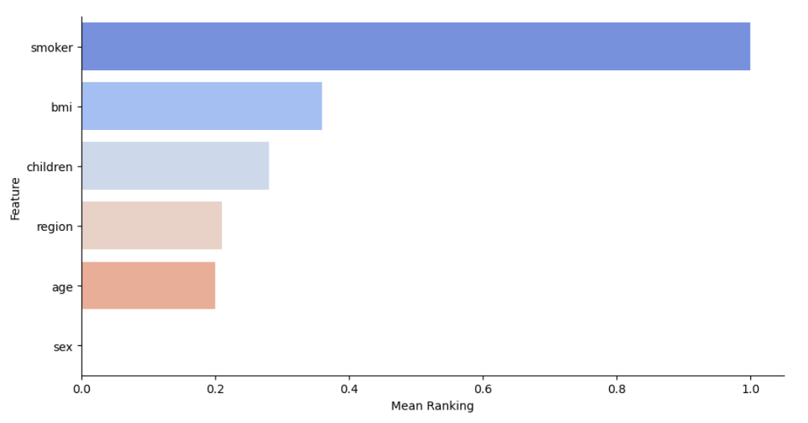
EDA and Data Insights

Slide 9
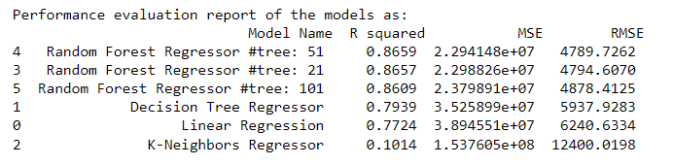
ML Models performance evaluation report

Slide 10
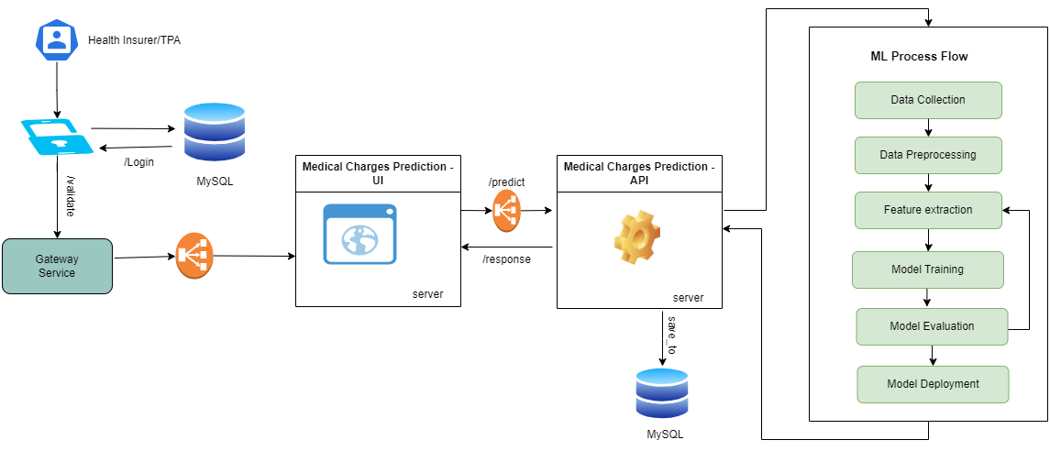
System Design: System and ML Architecture

Slide 11
Business Imperative and Consumption Content
Factors Affecting Medical Charges:
Smoking: Examine the difference in charges between smokers and non-smokers. Smokers incurred more charges than non-smoker
BMI (Body Mass Index): Analyze the impact of BMI on medical charges. Higher BMI correlate with higher charges
Number of Children: Investigate how the number of dependents affects medical charges. Charges are higher for individuals with less dependents
Age: Explore how medical charges vary across different age groups. Are there trends or patterns?
Region: Analyze geographical variations in medical charges across different regions in the US.

Slide 12
Business Key Performance Indicators (KPIs)
Total Revenue: Track the overall revenue generated from medical charges.
Customer Satisfaction: If applicable, measure patient satisfaction through surveys or feedback.
Cost Management: Assess the efficiency of cost management strategies.

Slide 13
MLOps
CI/CD: Continuous Integration and continuous deployment (CI/CD) pipelines
Prepare the Model: Ensure the model is trained and evaluated.
Containerization: Dockerize the model for portability.
Orchestration: Use Kubernetes for managing containers.
Load Balancing: Implement a load balancer for distributing incoming requests.
Canary Deployment: Gradual rollout with monitoring for any issues.
Continuous Monitoring: Monitor the deployed model for performance.

Slide 14
Thank You

